Slide 1
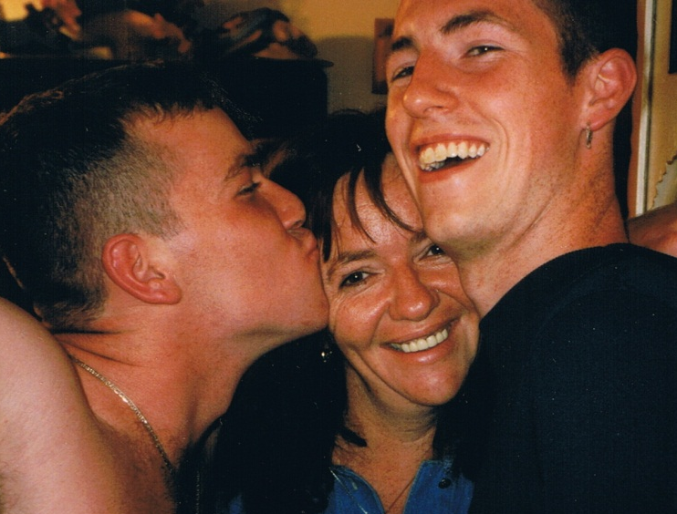
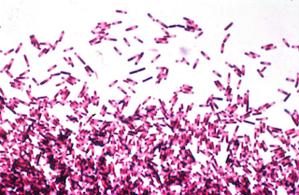
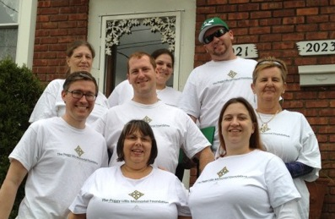
Effective Policy Advocacy for Patients: What’s Required?
Alliance for Aging Research
September 2014

Slide 2
Mission
The Peggy Lillis Foundation is building a nationwide Clostridium difficile awareness movement by educating the public, empowering advocates and shaping policy.

Slide 3
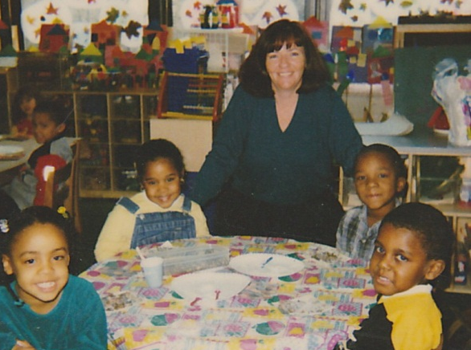
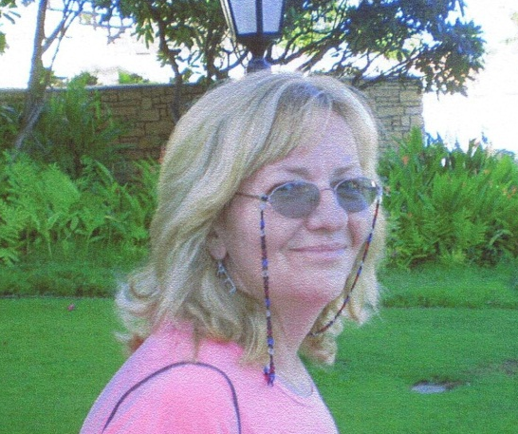
About Peggy
56-year-old Kindergarten teacher/Part-time waitress
Former welfare recipient
3rd of 9 children from Irish-Catholic, working class, Brooklyn family
Single Mother of 2 sons
Godmother to 12
Master’s degree candidate
Community Acquired C. diff
Died from C. diff in April 2010

Slide 4
Accomplishments: 2010 - 2013
Educating the Public: First website dedicated to C. diff sufferers and their families; First-ever C. diff Public Service Announcement with more than 10,000 views; and distributing hundreds of C. diff Awareness t-shirts, water bottles and tote bags
Raising C. diff Awareness in the Media: Worked with reporters to gather 18 diverse stories from C. diff sufferers for USA Today ’s ground-breaking August 2012 cover story, “Far more could be done to stop the deadly bacteria C. diff”; collaborated with reporters at Reuters, The Stockdale Record, and the Associated Press; and placed op-eds in the Baltimore Sun, The Albany Times Union and The New York Times
Engaging Federal and Elected Officials: Built a partnership with the Centers for Disease Control; worked with Congresswoman Louise Slaughter to highlight antibiotic overuse as a key driver of C. diff; and shared Peggy’s story in Dr. Beth Bell’s testimony before the Senate Subcommittee on Health, and in lobbying for budget increase for CDC

Slide 5
Accomplishments: 2010 – 2013 (Cont.)
Emphasizing the “Face of C. diff”: Shared C. diff sufferers’ stories through our website and social media and presented the patient perspective to hundreds of healthcare workers at quality improvement meetings in North Carolina, Maryland, Colorado and Ohio
Engaging C. diff experts within the healthcare industry: Established relationships with healthcare centers, including Beth Israel Hospital as well as individual physicians and scientists, including Dr. Martin Blaser of NYU Langone Medical Center, Dr. Moshe Rubin of New York Hospital Queens, Dr. Tor Savidge of Baylor, and Garrett Lawlor of Veterans Affairs New York Safe Harbor Hospitals
Building a National Movement: Grew to 2,000+ supporters nationwide, including C. diff sufferers, their families, physicians and corporate leaders; involved experts in medicine, public health, patient safety, and health policy through our National Advisory Council; raised $250,000 through our annual FIGHT C. DIFF Gala to fuel our work; and started partnerships with pharmaceutical, vaccine, diagnostic testing and environmental hygiene companies

Slide 6
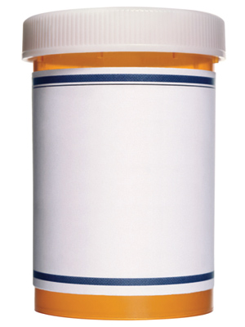
Key C. diff Issues
Prevalence
Risk Factors
Aged 65 and over
Current or recent antibiotic use
Proton pump inhibiting antacids
Dearth of Public Awareness
Mythology Among Doctors and HCWs
Antibiotics

Slide 7
Prevalence
Approximately 700,000 new cases of C. diff occur in the US each year
Between 2001 and 2009, CDI hospital stays more than doubled to 336,600
CDI-related deaths increased 10-fold between 1999 and 2011
C. diff was the 17th leading cause of death for people 65 years and older
In 2012, an estimated 17,000 children were diagnosed with CDI

Slide 8
Official Estimates = Tip of the Iceberg
14,000 deaths according to CDC
28,000 deaths
according to HHS
108,000 deaths
2008 prevalence study
Nursing Home Deaths
(Unreported)
Community Deaths
(Unreported)

Slide 9
Unreported Deaths
No C. diff!

Slide 10
CDI Risk Factors
Taking or having recently taken antibiotics
Aged 65 years or older
Recent stay in hospital or long-term care facility
Weakened immune system
Past CDI
Use of proton-pump inhibiting antacids
Inflammatory bowel disease

Slide 11
C. diff Deaths
Table. Demographic characteristics of patients with Clostridium difficile–related deaths, United States, 1999–2004
Demographic group |  | C. difficile-related deaths, no. (%) |  | Age-adjusted mortality million
Sex
Female |  | 12,468 (60) |  | 11.8
Male |  | 8,174 (40) |  | 12.7
Race/ethnicity
White |  | 18,534 (90) |  | 12.9
Hispanic |  | 602 (3) |  | 7.2
Black |  | 1,304 (6) |  | 9.3
Asian/Pacific Islander |  | 130 (1) |  | 3.5
Native American/Alaska native |  | 63 (<1) |  | 7.9
Age group, year
<1 |  | 17 (<1) |  | 0.7
1-4 |  | 11 (<1) |  | 0.1
5-14 |  | 12 (<1) |  | 0.1
15-24 |  | 24 (<1) |  | 0.1
25-34 |  | 62 (<1) |  | 0.3
35-44 |  | 171 (1) |  | 0.6
45-54 |  | 464 (2) |  | 2.0
55-64 |  | 1,159 (6) |  | 7.6
65-74 |  | 3,238 (16) |  | 29.3
75-84 |  | 7,850 (38) |  | 104
≥ 85 |  | 7,623 (37) |  | 287.1
Total |  | 20,642 |  | 12.2

Slide 12
Dearth of Public Awareness
Unlike MRSA and pneumonia, C. diff has yet to capture the public’s attention
In a recent PLF survey:
64% of CDI sufferers first heard of C. diff when they were diagnosed
34% said prior knowledge would made the biggest non-medical difference
Market research indicates less than 20% of the American public has heard of C. diff

Slide 13
Mythology among Doctors & HCWs
C. diff is a “nuisance” disease
Antibacterial gels kill C. diff
C. diff only afflicts immune-suppressed seniors
Current treatments are sufficient

Slide 14
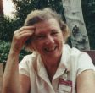
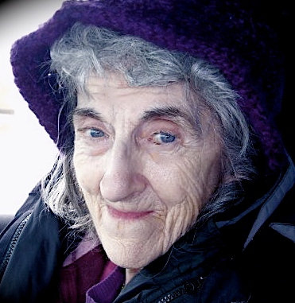
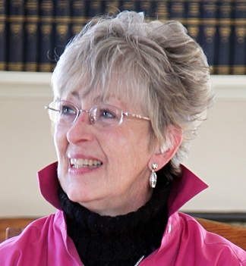
C. diff Stories
 | Regina M. 86. New York City. Hospital acquired CDI following two heart surgeries (the second to correct an an artery nicked in the first). Became symptomatic during rehab. Doctors downplayed dangers of CDI. Family assumed she was getting better. Two days before she was due to be released Regina had a recurrence that led to her death.
 | Arne S. 87. Connecticut. Hospital-acquired CDI following emergency surgery for an intestinal obstruction. Recovered well. Minor infection of the surgical site led to antibiotic being prescribed. Arne came down with severe diarrhea and lost her appetite. She was readmitted to the hospital where she later died from her CDI.
 | Trisha P. 61. Kansas. Recurrent hospital and community-acquired CDIs while waiting for a kidney transplant. CDI led to SIBO, which led to intestinal failure. Was offered hospice but refused and sought further treatment. Currently placed on Total Parenteral Nutrition and facing homelessness due inability to work because of her ongoing CDI-related health issues.

Slide 15
Lessons Learned: 2010 – 2013
Since starting PLMF in June 2010, we have learned several important lessons that inform our work to building a movement:
Like many infectious diseases, building a patient/citizen constituency around C. diff is challenging, because people “die or get better”
Inadequate medical education and public awareness among sufferers, caregivers and healthcare workers delays diagnosis and limits treatment options offered, including new treatments like DIFICID and FMT
Shame related to feces inhibits sufferers from seeking care and survivors from discussing their experience
The people most interested in raising awareness and engaging in advocacy have either lost a loved one (usually an elderly person) to C. diff or suffered from multiple recurrences

Slide 16
PLF’s Strategic Plan
Educate National
Audience
Empower
Advocates
Shape
Policy
Website re-launch National distribution of updated PSA Core public education toolkit deployed Phased consumer education programs executed | Train C. diff sufferers to be powerful advocates Map state regulations, physicians, organizations Engage immune-suppressed populations Catalyze local and national campaigns | Position citizen advocates on state HAI advisory committees Push legislation for HAI reporting by long-term care facilities Coordinate statewide lobbying efforts
Build Organizational Capacity To Fulfill Mission
2014 | 2015 | 2016
Recruit founding Board Secure $200,000 | Hire full-time ED Refocus Advisory Council Secure $350,000 | Hire additional staff Develop next 3-year plan Secure $500,000
Notes:
While the overall strategies will play out in varying degrees throughout the next three years, PLF’s focus on each of these strategies will tracks from education in 2014, empowerment in 2015 and shaping policy in 2016.

Slide 17
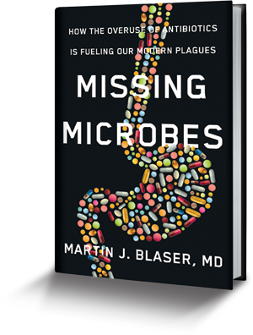
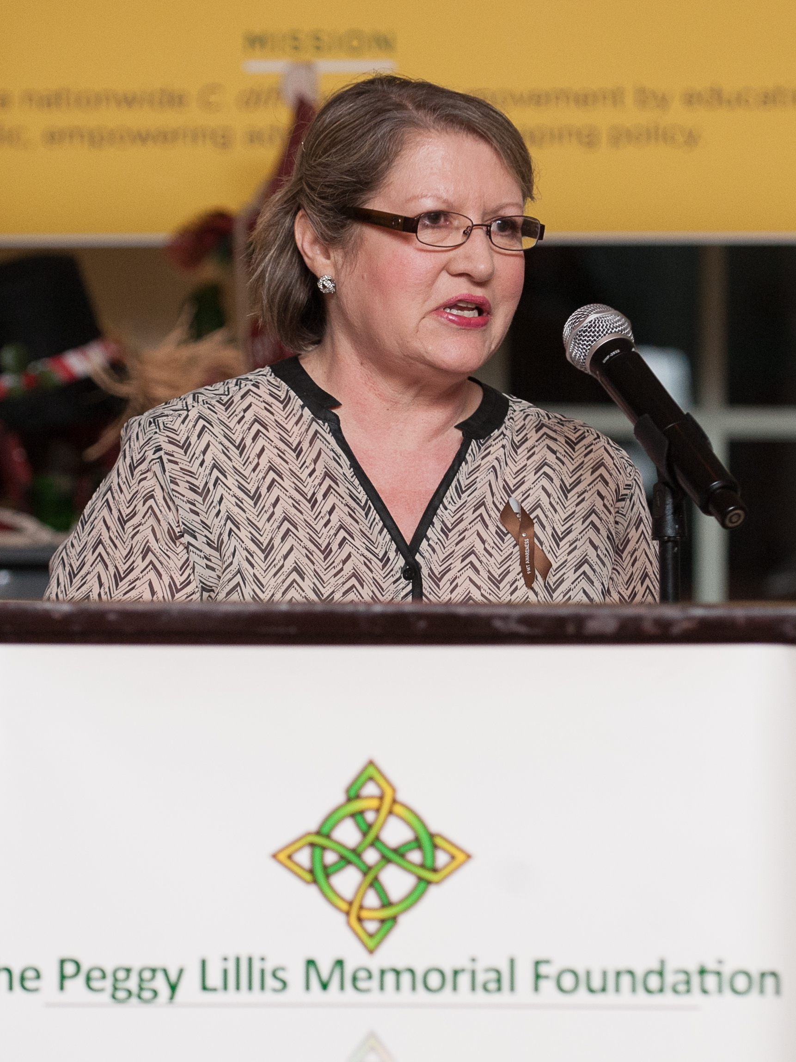
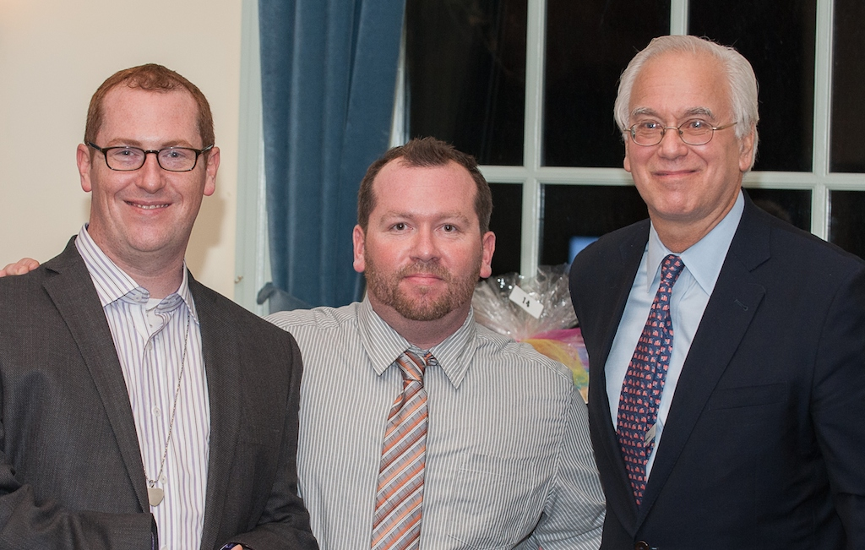
Engaging physicians & patients to drive change
Building a nationwide database of C. diff experts
Collaborating on C. diff policy at the state and federal levels (ADAPT Act, CDC)
Sharing individual patient stories (70+ to date) and aggregate survey data
Serving as patient collaborator for PCORI and other grants
How else can we partner?

Slide 18
Example: Draft state web page
New York Providers
Moshe Rubin, MD
New York Hospital Queens
Specialty: Gastroenterology
Treatments: Antibiotics
Contact this physician
Rate this physician
Jane Doe, MD
NYU Medical Center
Specialty: Infectious Diseases
Treatments: Fecal microbiota transplant
Contact this physician
Rate this physician
John Smith, MD
Private Practice
Specialty: Gastroenterology
Treatments: All
Contact this physician
Rate this physician
New York Advocates
Christian John Lillis
Christian lost his mother to C. diff in April 2010
Areas: Public speaking, lobbying, print, audio and video media
Contact Christian
Gina Del Re
Mother of a two-year old son who survived C. diff
Areas: Lobbying, print, audio and video media
Read Gina’s Story
Contact Gina
State Laws & Regulations
Public Reporting
Treatment
Et cetera
Take Action in New York
Sign our petition to mandate HAI reporting by nursing homes
Contact Your Local Legislators

Slide 19
We have the knowledge & technology…
We know how to minimize transmission in hospitals
High degree of hand washing and sanitation compliance
Vigorous environmental cleaning coordinated with Infection Control
Active detection and isolation of suspected carriers
Antibiotic stewardship
Education of patients and visitors
New technologies from more sensitive tests to UV cleaning technologies are emerging regularly
The missing ingredient is the will

Slide 20
Areas for Collaboration
Research for prevention (CDC, vaccines) and treatment (Ebiotics, FMT, etc.)
Raising awareness of underutilized treatments (FMT and Fidaxomicin)
Increasing transparency (public reporting of LTC facilities HAI rates)
Advocating for increased public and private funding
Patient education (particularly around antibiotic overuse and HAI risk factors and symptoms)

Slide 21
Engaging Seniors & Caregivers
PLF’s 2015 Advocates Summit
Ongoing Advocates Council
Partnering to Raise Awareness
Organizing support for federal and local policy and legislative change
Sharing Resources for Treatment and Patient Support

Slide 22
“All you have in this world is each other.” - Peggy Lillis

Slide 23
Peggy’s Vision
A World Where C. diff is
Rare, Treatable and Survivable.

